Slide 1

COMP3851B FINAL PROJECT REPORT
Gig Job Placement Services
(Gigo App)
Bridging the gap in the Gig Economy through Real-Time Matching
PROJECT MANAGER
TEAM MEMBERS
Yiheng Li
[Member A], [Member B]
[Member C], [Member D]

Slide 2
Presentation Agenda
01. Introduction
Project overview and mission statement.
05. System Architecture
Client-Server model explanation.
02. Industry Context
Understanding the market gap.
06. Methodology
Agile development process.
03. Solution Overview
How Gigo addresses the problem.
07. Key Results
Showcasing the functional app.
04. Technical Evolution
Strategic pivot to React Native.
08. Ethics & Conclusion
Frameworks and future work.

Slide 3

Introduction
Project Overview
This report documents the successful transition of the Gigo App from a conceptual prototype (Part A) to a fully functional software artifact (Part B).
Key Achievement
Successfully deployed a cross-platform mobile application with secure authentication, real-time filtering, and transactional integrity.
The Mission
To create a seamless, transparent, and real-time platform that connects time-sensitive employers with the growing gig workforce in Southeast Asia.

Slide 4
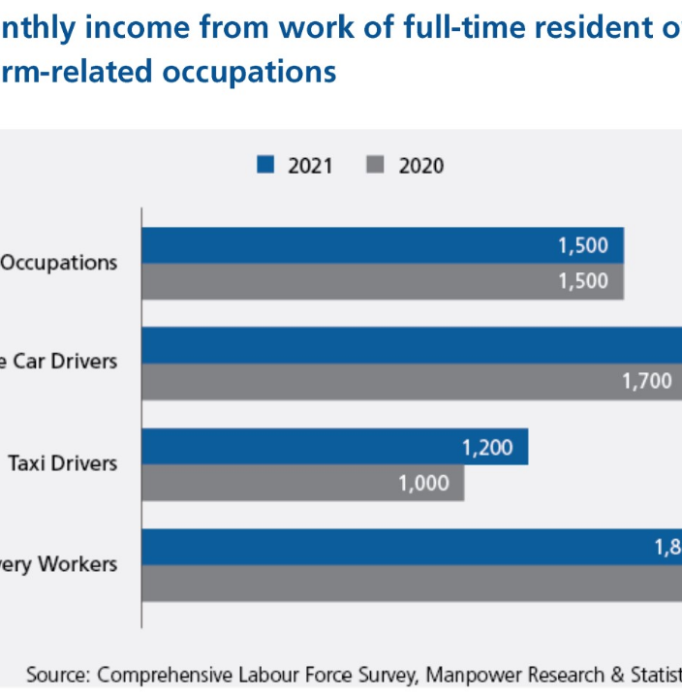
Industry Context
High Frequency Demand:
The logistics and retail sectors in Singapore require short-term labor on demand.
Market Size:
The Global Gig Economy is projected to reach $873 Billion by 2028 (Statista).
The Gap:
Current infrastructure is fragmented across informal channels like WhatsApp, leading to inefficiency.

Slide 5






The Problem: "Information Void"
Too Slow
"Ghosting"
Lack of Trust
Traditional platforms like LinkedIn require long CVs and cover letters, unsuitable for urgent shift work.
Job seekers rarely receive feedback on their applications, creating a "double-blind" inefficiency.
Informal job postings on social media lack verification and security for both parties.

Slide 6

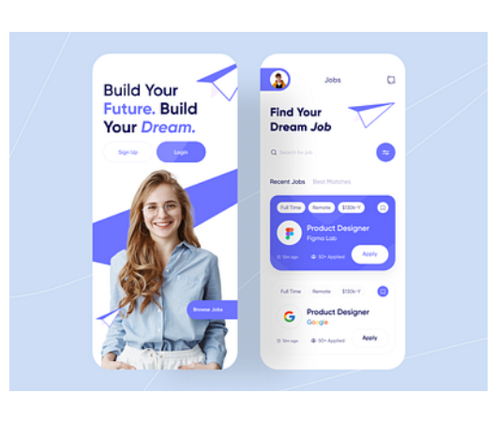
Our Solution: Gigo App
Mobile-First Design
Optimized for speed and accessibility on iOS and Android devices.
Real-Time Matching
Deterministic filtering engine allows instant discovery of relevant jobs.
Closed-Loop Feedback
Integrates status tracking directly into the user dashboard (Pending → Viewed → Accepted).

Slide 7
Competitor Analysis
Feature | Indeed / LinkedIn | FastJobs | Gigo (Us)
Target Audience | White-collar / Corporate | Blue-collar / General | Gig / Casual Labor
Application Speed | Slow (CV Required) | Medium | Instant (One-Tap)
Feedback Loop | Email-based (Slow) | Limited | Real-time Dashboard
Data Security | High | Moderate | High (RLS Enforced)

Slide 8


Technical Evolution
A strategic pivot was made during the implementation phase to ensure scalability and performance.
Part A (Proposal)
Part B (Implementation)
Frontend: .NET MAUI
Frontend: React Native (Expo)
Backend: Firebase (NoSQL)
Backend: Supabase (PostgreSQL)
Limitation: Limited component ecosystem and data consistency issues.
Advantage: Superior cross-platform performance and relational data integrity.

Slide 9

System Architecture
Client-Side
Built with React Native (Expo). Handles UI rendering, navigation logic, and local state management.
Server-Side
Powered by Supabase. Provides:
PostgreSQL Database (Relational Store)
Authentication (Identity Management)
Edge Functions (Business Logic)

Slide 10

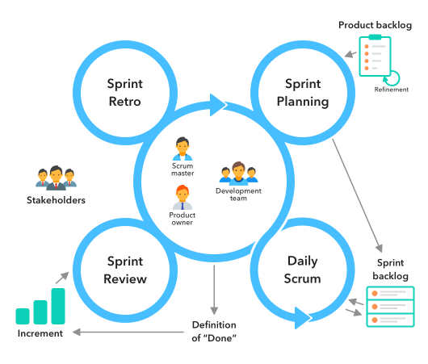
Agile Methodology
Modular Development
Decomposed into 4 independent modules to allow parallel work:
Module A: Auth & Infrastructure
Module B: Discovery Engine
Module C: Transaction Logic
Module D: Data Persistence
Workflow: Gitflow Branching & Pull Requests.

Slide 11


Results: Authentication
Functional Outcome
Fully implemented Login/Register flow using Supabase Auth.
Session Persistence: Users remain logged in via Async Storage tokens.
Error Handling: Real-time feedback for invalid credentials.
Security: Passwords hashed (bcrypt) before storage.

Slide 12

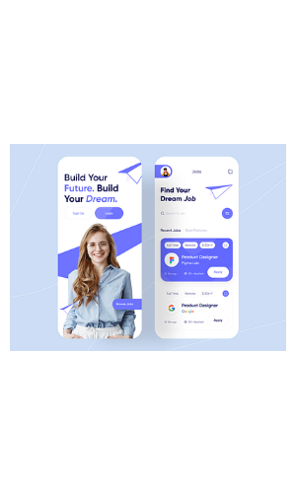
Results: Discovery Engine
Functional Outcome
The core value proposition realized. Users can filter large datasets in real-time.
Performance: Uses React Native FlatList for smooth scrolling.
Logic: Server-side SQL filtering ensures scalability.
UI: Dynamic filtering modal for Industry and Salary.

Slide 13
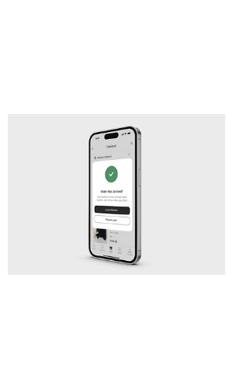
Results: Application Workflow
Closed-Loop Transaction
Successfully digitized the application process with transactional integrity.
Atomic Insert: Links user_id to job_id in the database.
Feedback: Instant "Success" popup confirmation.
Prevention: Backend constraints prevent duplicate submissions.

Slide 14
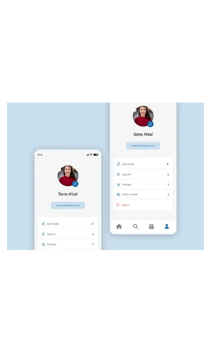
Results: Profile Management
Data Persistence
Complete CRUD (Create, Read, Update, Delete) capabilities for user data.
Sync: Real-time synchronization with PostgreSQL.
Customization: Users can edit skills and bio.
Privacy: Users can strictly only modify their own data.

Slide 15






Ethics & Conclusion
Privacy
Fairness
Conclusion
Row Level Security (RLS) implemented to ensure strict data isolation.
Avoided "Black Box" AI. Chronological sorting ensures equal visibility.
Successfully transitioned from concept to a scalable, secure product.
Thank You. Questions?

Slide 16
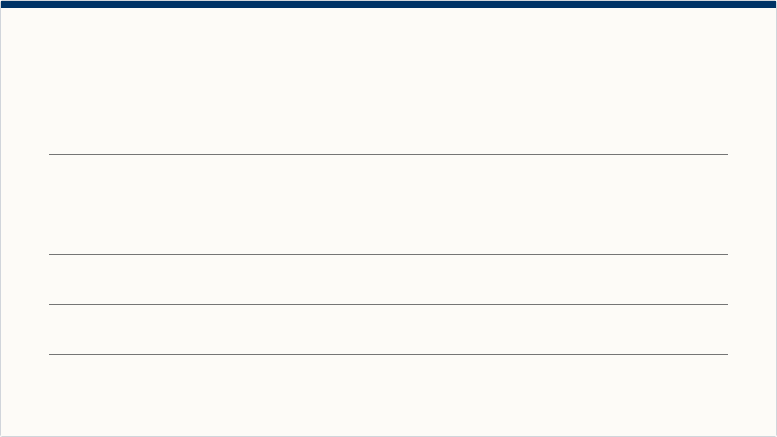






Image Sources
https://dollarsandsense.sg/wp-content/uploads/2022/03/platform-workers-1-income.jpg
Source: dollarsandsense.sg
https://cdn.dribbble.com/userupload/3815919/file/original-0ca0ef639fa11e96a6ba657614b3697e.png?resize=400x0
Source: dribbble.com
https://startinfinity.s3.us-east-2.amazonaws.com/t/xxFYvXnlAeya4B2AkWuYLJhxeNQ9DyVarRxv7CaJ.png
Source: startinfinity.com
https://insights.daffodilsw.com/hubfs/Frame%201%20%281%29.png
Source: insights.daffodilsw.com
https://cdn.dribbble.com/userupload/42714600/file/original-326070fb5bb809d72d751f485d75c106.png?resize=400x0
Source: dribbble.com
https://cdn.dribbble.com/userupload/15258786/file/original-5aa712451525498cee4ff34545017127.png?format=webp&resize=400x300&vertical=center
Source: dribbble.com

